Slide 1
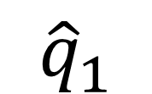
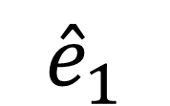


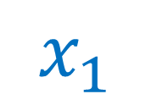

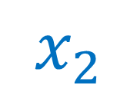
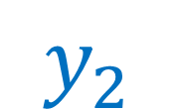


$${\hat{e}}_{1}$$
$${\hat{q}}_{1}$$
$$\vec{r}$$
$$\vec{r}$$
$$x_{1}$$
${\hat{q}}_{2}$
$$y_{2}$$
$$y_{1}$$
${\hat{e}}_{2}$
$$x_{2}$$

